Slide 1
DATA SCIENCE
11 WEEK PART TIME COURSE
Week 7 - Ensembling with Decision Trees
Wednesday 4th May 2016

Slide 2
AGENDA
Guest Speaker - Sidney Minassian (Contexti)
Review of Decision Trees
Ensembling
Bagging
Random Forest
Boosting
Lab
Other Uses
Discussion

Slide 3
DECISION TREES
DATA SCIENCE PART TIME COURSE

Slide 4
WHAT ARE DECISION TREES?
A supervised learning technique that can be used for classification or regression.
Visually engaging and easy to interpret.
Foundation for getting into very powerful techniques.
Great for explaining to people!

Slide 5
DECISION TREES - HOW IT WORKS
Scans for a feature to split on that results in the greatest separation between classes in the resulting nodes.
Non-linear
Greedy process
Splits within splits
For a classification tree, we predict that each observation belongs to the most commonly occurring class of training observations in the region to which it belongs.
We naturally get combinations of features used for our prediction.

Slide 6
DECISION TREES - SHORTCOMINGS
Prone to overfitting.
Predictive power is lower in comparison to many other modern techniques.
They suffer from high variance

Slide 7
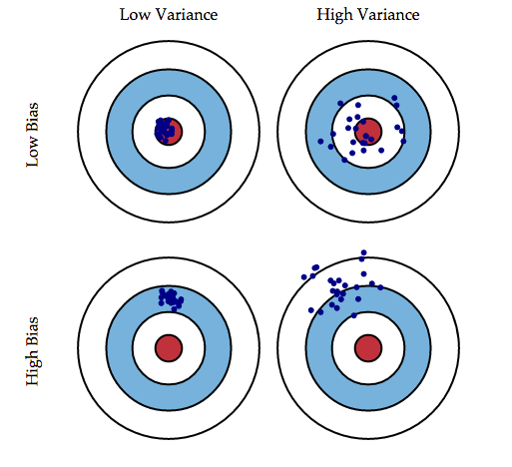
BIAS - VARIANCE TRADEOFF
7￼

Slide 8

BIAS - VARIANCE TRADEOFF

Slide 9
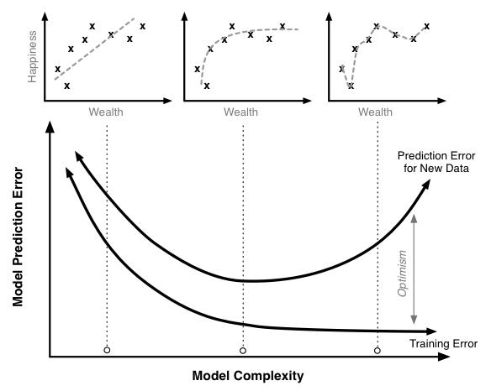
BIAS - VARIANCE TRADEOFF

Slide 10
DECISION TREES
HOW DO WE IMPROVE DECISION TREES ?

Slide 11
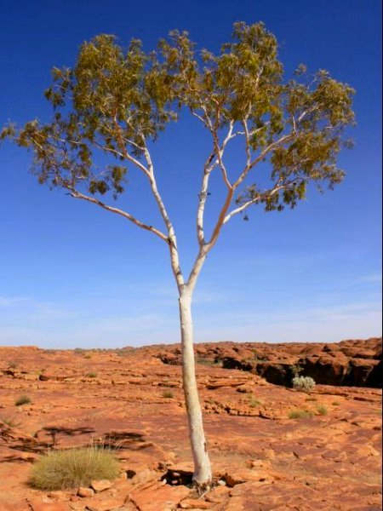
DECISION TREES

Slide 12
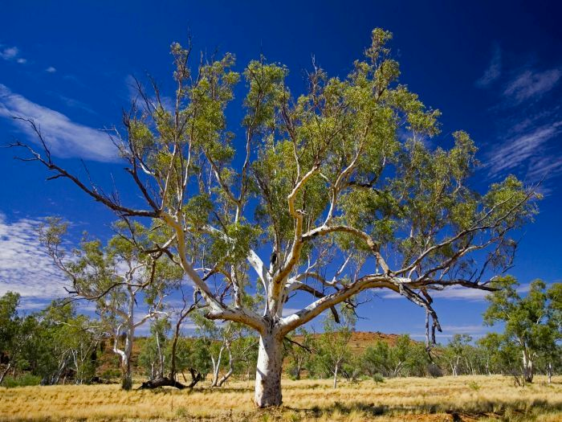
DECISION TREES

Slide 13
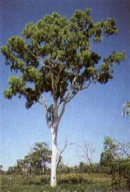
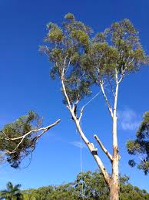
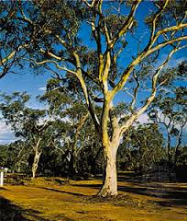
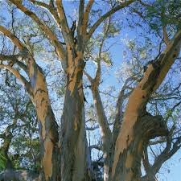
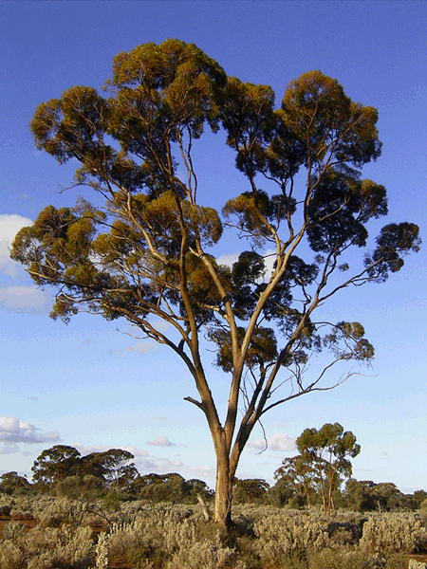
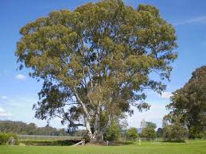
DECISION TREES

Slide 14
BAGGING
DATA SCIENCE PART TIME COURSE

Slide 15
BOOTSTRAP & BAGGING
Bootstrapped Aggregation = Bagging
The bootstrap is a statistical technique that is used to quantify the uncertainty of a model
Bootstrap samples are simply random samples with replacement

Slide 16
BAGGING
What is the bagging process?
Take repeated bootstrap samples (random samples with replacement) from the training data set
Train our method on each bootstrapped training set and make predictions
Average the predictions

Slide 17
BAGGING
This increases predictive accuracy by reducing the variance, similar to how cross-validation reduces the variance associated with the test set approach (for estimating out-of-sample error) by splitting many times an averaging the results.

Slide 18
BAGGING
Specifically to Decision Trees
Grow B regression trees using B bootstrapped training sets
Grow each tree deep enough that each one has low bias
Every tree makes a numeric prediction, and the predictions are averaged (to reduce the variance)
What value should be used for B?

Slide 19
DECISION TREES
HOW DO WE IMPROVE BAGGED DECISION TREES ?

Slide 20
ENSEMBLING
DATA SCIENCE PART TIME COURSE

Slide 21
ENSEMBLE MODELS
Ensemble learning (or "ensembling") is simply the process of combining several models to solve a prediction problem, with the goal of producing a combined model that is more accurate than any individual model.
For classification problems, the combination is often done by majority vote.
For regression problems, the combination is often done by taking an average of the predictions.

Slide 22
ENSEMBLE MODELS - WHEN DO THEY WORK?

Slide 23
ENSEMBLE MODELS - WHEN DO THEY WORK?
For ensembling to work well, the individual models must meet two conditions:
Models should be accurate (they must outperform random guessing)
Models should be independent (their predictions are not correlated with one another)

Slide 24
RANDOM FORESTS
DATA SCIENCE PART TIME COURSE

Slide 25
RANDOM FORESTS
Random Forests is a slight variation of bagged trees that has even better performance! Here's how it works:
Exactly like bagging, we create an ensemble of decision trees using bootstrapped samples of the training set.
However, when building each tree, each time a split is considered, a random sample of m predictors is chosen as split candidates from the full set of p predictors. The split is only allowed to use one of those m predictors.

Slide 26
RANDOM FORESTS
However, when building each tree, each time a split is considered, a
random sample of m predictors
is chosen as split candidates from the
full set of p predictors.
The split is only allowed to use one of those
m predictors.

Slide 27
RANDOM FORESTS
Notes:
A new random sample of predictors is chosen for every single tree at every single split.
For classification, m is typically chosen to be the square root of p. For regression, m is typically chosen to be somewhere between p/3 and p.

Slide 28
RANDOM FORESTS
What's the point?
Suppose there is one very strong predictor in the data set. When using bagged trees, most of the trees will use that predictor as the top split, resulting in an ensemble of similar trees that are "highly correlated".
Averaging highly correlated quantities does not significantly reduce variance (which is the entire goal of bagging).
By randomly leaving out candidate predictors from each split, Random Forests "decorrelates" the trees, such that the averaging process can reduce the variance of the resulting model.

Slide 29
VARIABLE IMPORTANCE
Although bagging increases predictive accuracy, it decreases model interpretability because it's no longer possible to visualize the tree to understand the importance of each variable.
To compute variable importance for bagged regression trees, we can calculate the total amount that the mean squared error is decreased due to splits over a given predictor, averaged over all trees.
A similar process is used for bagged classification trees, except we use the Gini index instead of the mean squared error.

Slide 30
OUT-OF-BAG ERROR
Bagged models have a very nice property: out-of-sample error can be estimated without using the test set approach or cross-validation. How it works:
On average, each bagged tree uses about two-thirds of the observations. For each tree, the remaining observations are called "out-of-bag" observations.
For the first observation in the training data, predict its response using only the trees in which that observation was out-of-bag. Average those predictions (for regression) or take a majority vote (for classification).
Repeat this process for every observation in the training data.
Compare all predictions to the actual responses in order to compute a mean squared error or classification error. This is known as the out-of-bag error.

Slide 31
DECISION TREES
WHAT ELSE COULD WE DO TO IMPROVE DECISION TREES ?

Slide 32
BOOSTING
DATA SCIENCE PART TIME COURSE

Slide 33
BOOSTING
Boosting involves the base learners being built sequentially (using previous models). The aim is to reduce the bias of the combined estimator.
Compare this to something like bagging where the models are built independently of one and other.

Slide 34
ADABOOST - ADAPTIVE BOOSTING
AdaBoost works by building sequential models on re-weighted versions of the data. Initially all data points have the same weighting = 1/N.
After the first model the error on the points is evaluated and the weighting for each observation is adjusted. So if we fit a model and an observation has a large difference between the observed and predicted we give that observation a higher weighting and run the model again.
This means observations that are difficult to predict become more influential in the model.

Slide 35
GRADIENT BOOSTING
Gradient Boosting is a technique that are sequentially fitted that minimise a loss function. For regression this might be the square loss. So we would be updating the model based on Gradient Descent.
This differs to AdaBoost where the boosting was performed by re-weighting the original observations.

Slide 36
eXtreme Gradient Boosting
XGBoost is an optimized distributed gradient boosting library designed to be highly efficient, flexible and portable. It implements machine learning algorithms under the Gradient Boosting framework. XGBoost provides a parallel tree boosting(also known as GBDT, GBM) that solve many data science problems in a fast and accurate way. The same code runs on major distributed environment(Hadoop, SGE, MPI) and can solve problems beyond billions of examples.
- https://github.com/dmlc/xgboost

Slide 37

LAB
DATA SCIENCE PART TIME COURSE

Slide 38
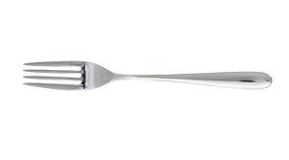
SYNCHING A FORK
git remote -v
git remote add upstream https://github.com/ihansel/SYD_DAT_3.git
git remote -v
git fetch upstream
git checkout master
git merge upstream/master
OR git reset --hard upstream/master

Slide 39
OTHER USES
DATA SCIENCE PART TIME COURSE

Slide 40
RANDOM FOREST FOR CLUSTERING
The idea is to create Synthetic data (fake data that is based on the original data set)
Then combine this fake data with your original data set
Assign a ‘Synthetic_data’ with 1 for the synthetic data and 0 for real data
Run the Random Forest model trying to predict ‘Synthetic_data’
You will have a ‘distance metric’ or ‘proximity’ which is basically how many times the samples occur in the same terminal nodes.

Slide 41
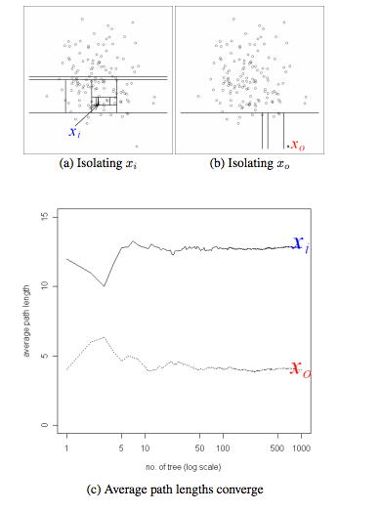
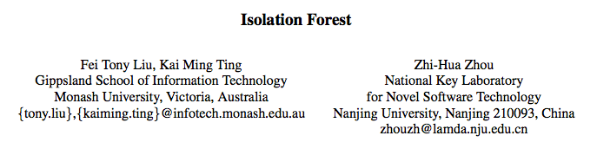
ISOLATION FOREST FOR OUTLIER DETECTION

Slide 42
RULEFIT = RANDOM FOREST + ELASTIC NET
Extract all the rules from all the trees and use them as features in an elastic net model.
Nice way to build a simpler more interpretable model

Slide 43
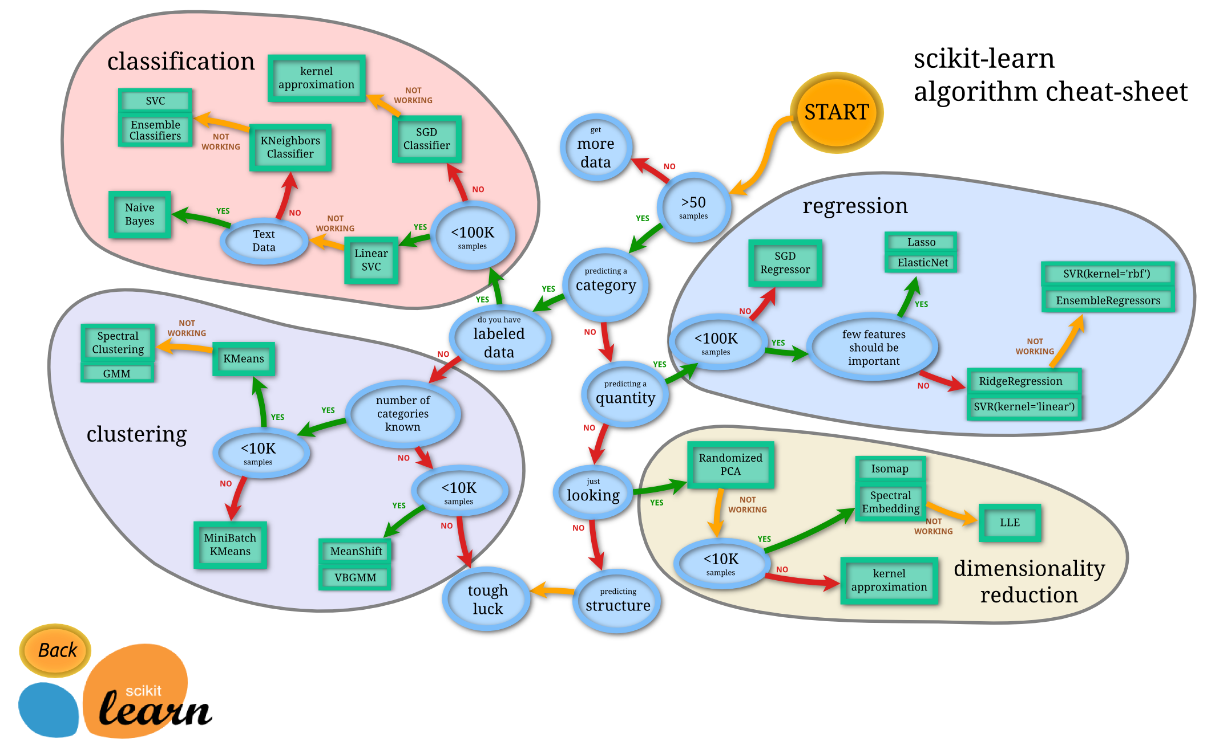

Slide 44
DISCUSSION TIME
Hackday
Rest of the course
Tasklist
DATA SCIENCE - Week 7 Day 2

Slide 45
HACKDAY
Saturday 7th May 10:00 - 3:00
Review topics completed done so far
AWS
Projects
DATA SCIENCE - Week 7 Day 2

Slide 46
COURSE REMAINDER
Practical Skills (Cloud)
Advanced Topics (Time Series, Graph Analysis, Neural Networks, Natural Language Processing)
Course Review
Project Presentations (Final 2 sessions)
Lots of guest presenters
DATA SCIENCE - Week 6 Day 2

Slide 47
Task List
Email me anything you’d like to review (previously been covered) by Thursday for Saturday
Email me anything you’d like to cover (not covered) by Thursday for Saturday
Work on your project
DATA SCIENCE - Week 7 Day 2

